Slide 1
The Science Behind Climate Change
Larry Olson
Environmental & Resource Management
Arizona State University
Larry.Olson@asu.edu

Slide 2
What is Climate Change?
The IPCC TAR-01 (Third Assessment Report, Chap 1), http://www.ipcc.ch/, defined weather as “the fluctuating state of the atmosphere around us, characterized by the temperature, wind, precipitation, clouds, and other weather elements.” Weather has only limited predictability (not much beyond a week).
Climate on the other hand “refers to the average weather in terms of the mean and its variability over a certain time span and a certain area.” Climate varies from place to place, season to season, year to year, or much longer time spans.
Climate change is not just a change in weather from day to day or week to week, or even year to year. Climate is more like “average weather.” Traditional averaging time for climate changes is at least 30 years.

Slide 3
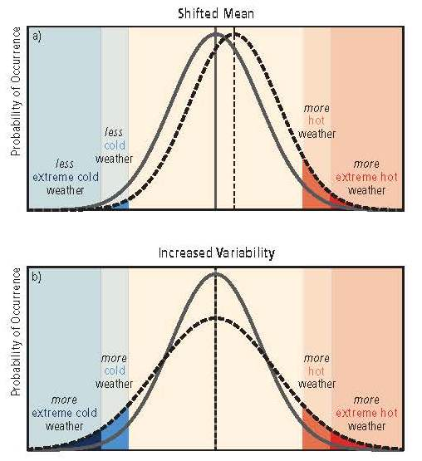
Characteristics of Climate Change
Climate change involves changes in both the magnitude of mean variables and changes in their variances (extremes).

Slide 4
Solar Radiation
The total energy flux from the sun reaching the area of space occupied by earth is called the solar constant. Averages about 1370 W/m².
Radiation from sun that strikes the earth spans the range from 200 nm to 50,000 nm. But it is concentrated in the visible range, with a maximum around 500 nm. About 47% of incident solar radiation is 380 – 780 nm. Infrared range (>780 nm) is another 46%. Ultraviolet (<380 nm) is about 7%.
Fortunately, most of the uv light is absorbed by the earth’s atmosphere and doesn’t make it to the surface.
The maximum intensity for solar radiation is about 483 nm (in the visible range) as shown on the next slide.

Slide 5
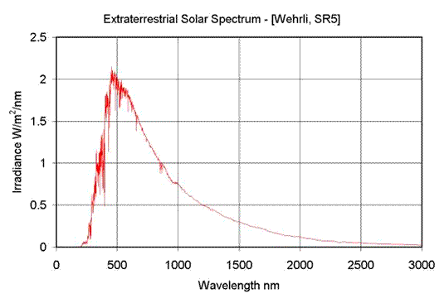
http://solardat.uoregon.edu/SolarRadiationBasics.html

Slide 6
Energy Balance
The earth must be in energy balance: no net gain or loss over time. So all energy absorbed by earth must eventually be radiated back into space for the earth’s temperature to remain constant.
But the energy absorbed doesn’t have to be at the same wavelength as the energy emitted.
The earth absorbs sun’s radiation which is mostly in visible range and radiates mostly in infrared range.
Earth absorbs energy with a maximum wavelength of 483 nm but radiates at a maximum wavelength of 10,000 nm.

Slide 7
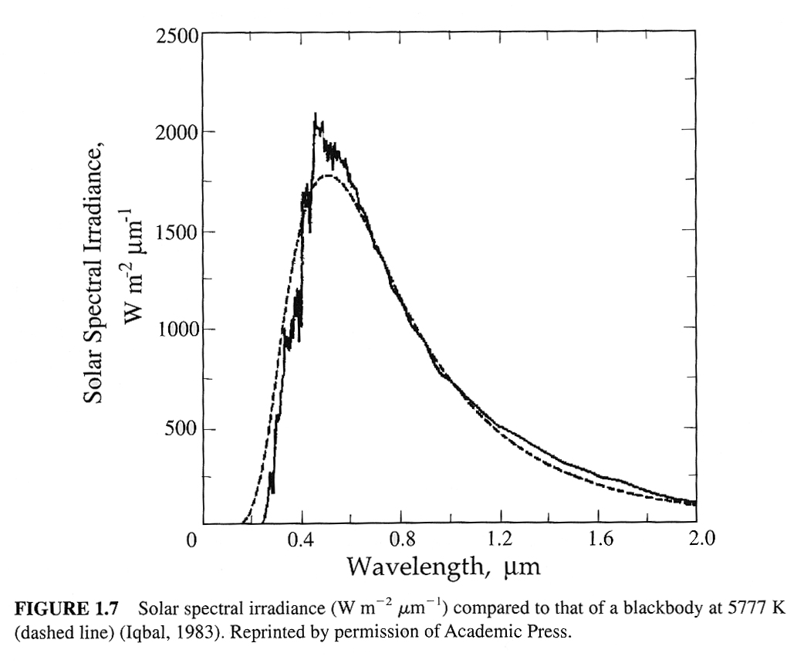
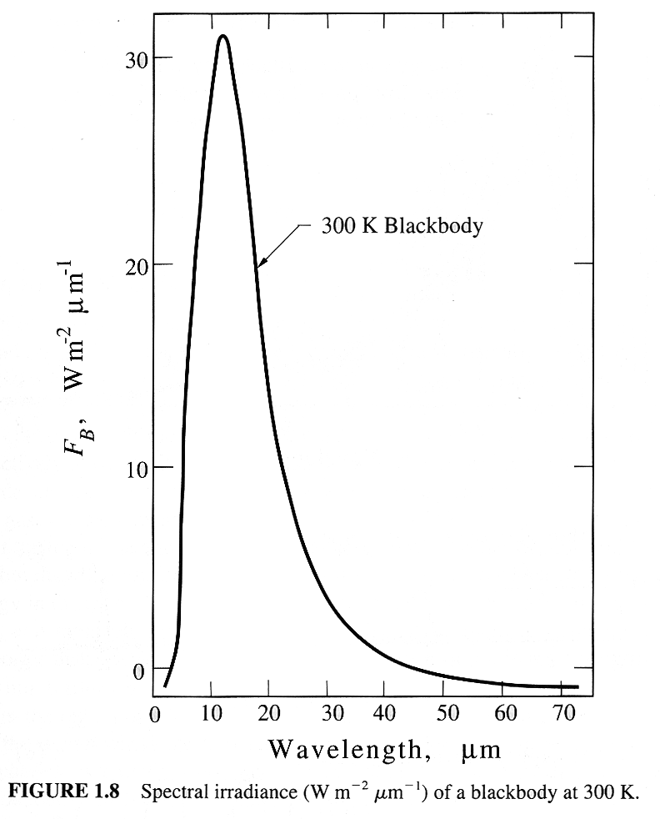
Seinfeld and Pandis, Atmospheric Chemistry and Physics, 1998

Slide 8
Temperature
Wein’s Law
  Temperature of a Black Body radiator is related to wavelength maximum in emission spectrum by the equation
  T = 2.9 x 10⁶ nm K / λ_{max} (nm)
  Notice that this equation means that as a Black Body is heated up, it not only gives off more radiation, but the radiation shifts to a smaller wavelength.
  Sun’s peak wavelength of 483 nm equates to a temperature of 6004 K.
  T = 2.9 x 10⁶ nm K/ 483 nm = 6004 K
  The earth also radiates energy back into space. It’s maximum wavelength (as viewed from space is about 10,000 nm – in the IR range). From Wein’s law, the earth acts as a Black Body radiator of about 288 K or +15 ºC

Slide 9
Stefan-Boltzman Equation
Rate of energy radiating from Black Body is a function of its temperature as shown by the Stefan-Boltzman equation.
S = kT⁴ where k = 5.67 x 10⁻⁸ watts/m² K
where S = rate at which the earth is radiating energy back into space.
The solar constant for incident radiation is 1370 W/m² but some of that energy is reflected back into space without being absorbed. This is called the albedo and is affected by clouds, snow and ice, pollution, volcanic emissions, etc. The ave albedo for the earth is about 0.3. Energy reflected and not absorbed does not affect the earth’s climate.
Absorption of the sun’s energy occurs in an area normal to the solar beam with an area = πr² where r = earth’s radius. But earth can radiate back into space from its entire surface area which = 4 πr².

Slide 10
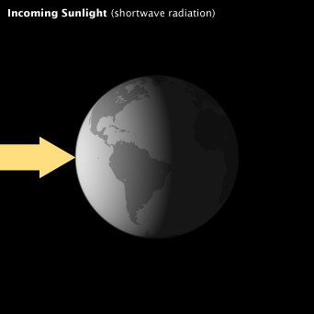
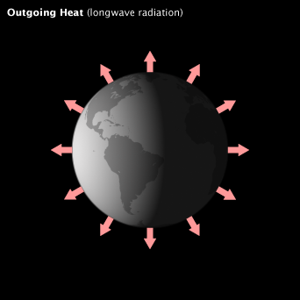
http://earthobservatory.nasa.gov/Features/EnergyBalance/printall.php

Slide 11
Greenhouse Effect
So amount of solar radiation that is absorbed and re-radiated is given by
  S = (1 - α) S_{o} / 4 = (1 – 0.3) 1370 watts/m² / 4 = 240 watts/m² radiated back into space from each meter of the earth’s surface
  So if we know the rate at which energy is radiating from the earth, we can calculate its temperature:
  240 watts/m² = T⁴ → T = 255 K
  5.67 x 10⁻⁸ watts/m² K = -18 ºC
  This would be the average temperature of the earth if there were no atmosphere. It is obviously much colder than the earth really is.
The difference in temperature calculated by the Stefan-Boltzman eq which assumes no atmosphere and the temperature from Wein’s law which is what the earth actually radiates is called the Greenhouse Effect. The earth is warmer by about 33 ºC than it would be without an atmosphere.

Slide 12
Greenhouse Effect
Why do gases in the atmosphere cause warming?
Atmospheric gases don’t absorb visible radiation which constitutes much of incoming radiation. But outgoing radiation is in the infrared and some atmospheric gases can absorb that.
What happens when IR radiation is absorbed?
  IR radiation isn’t energetic enough to cause chemical bonds to break, but it can cause bonds to vibrate (stretch).
  The two most common constituents of the atmosphere are N₂ and O₂ which are homonuclear diatomic molecules. For a diatomic molecule, there is only one possible vibrational mode: a stretching symmetric mode.
  ↔ ↔
N≡N or O=O

Slide 13
IR Absorption
For a molecular vibrations to be IR active, it must result in a change in the dipole moment of the molecule. (This is a consequence of quantum mechanics).
Dipole moment = charge x distance
  Thus, to have a dipole moment there has to be a separation of charge. But homonuclear diatomic molecules like N₂ and O₂ have no dipole and a symmetric stretch does not create one. Thus, N₂ is not IR active.
  But molecules with a permanent dipole are IR active.
  ← → ← → ← →
  N≡N ^{δ+}N≡O^{δ-} ^{δ+}C≡O^{δ-}

Slide 14
IR Absorption
As the number of atoms in a molecule increases, the number of potential vibrational modes increases. The formula is:
  3n-6 for non-linear molecules and 3n-5 for linear molecules, where n = number of atoms.
  Not all potential vibrational modes are active. Only those that change the dipole moment will actually result in absorption.
Molecules like H₂O, CO₂, CH₄, and N₂O have multiple vibrational modes, some of which are IR active.

Slide 15
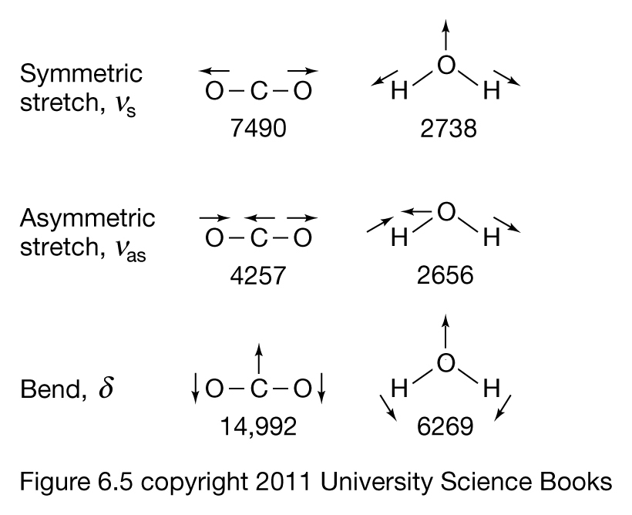

Slide 16
Atmospheric Windows
Water and carbon dioxide are the most important greenhouse gases in the atmosphere. They define the “atmospheric window” through which radiation from the earth can escape into space.
These “atmospheric windows” are 8000-12,000 nm and a smaller one ≈ 18,000 nm.
IR radiation from earth that isn’t in these windows is absorbed by water and CO₂ and results in heating the lower atmosphere. Radiation in the windows goes on out to space.

Slide 17
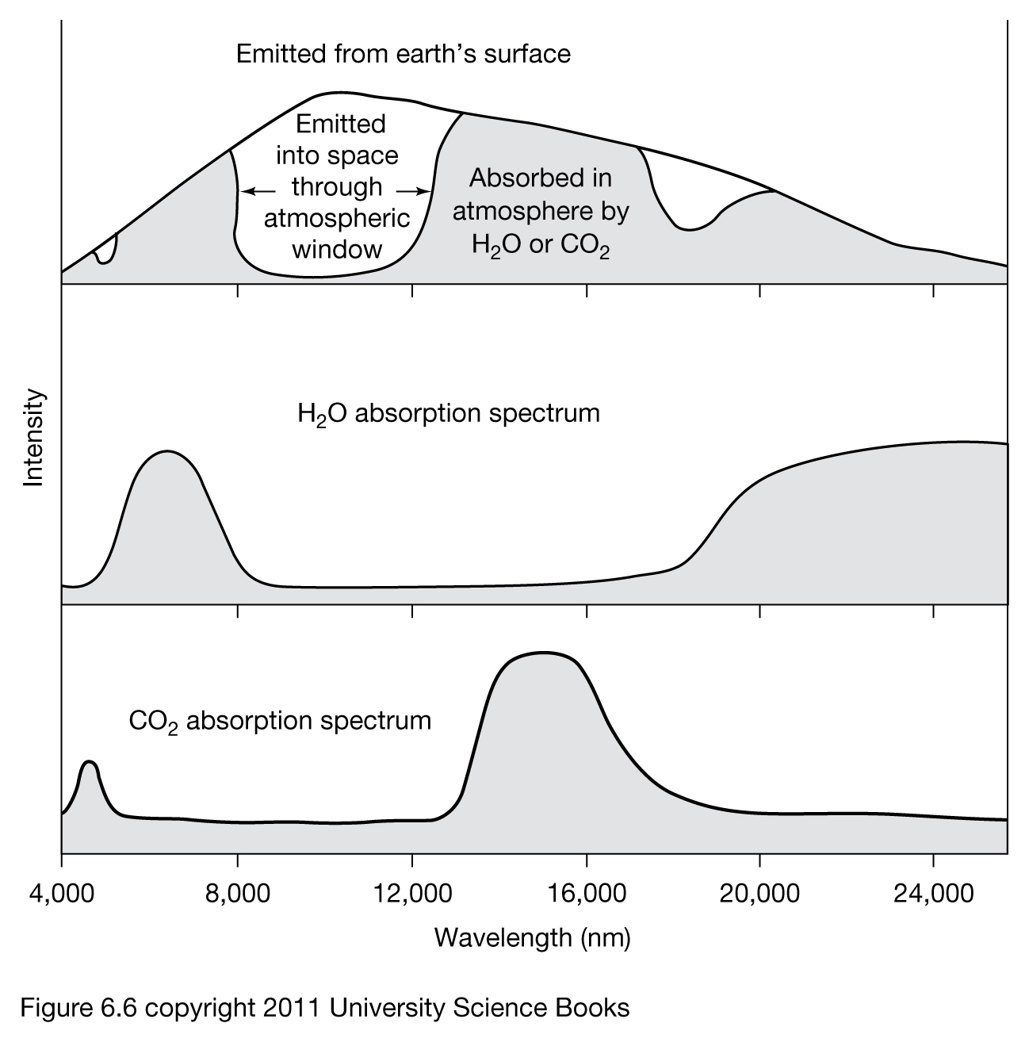

Slide 18
Greenhouse Gases
An increase in carbon dioxide or water can increase absorbance of radiation headed out to space and increase the warming of the atmosphere. But the effect is limited because absorbance is along the “edge” of the windows.
  Even though water vapor is a very important greenhouse gas, we usually don’t focus on it because it is dominated by natural processes (evaporation and transpiration).
A molecule which absorbs within the window will have a greater effect. We use the term radiative forcing to denote this. Carbon dioxide is assigned a radiative forcing of 1. Gases in the middle of the window can have much larger values. CFC-11 is 4000.

Slide 19
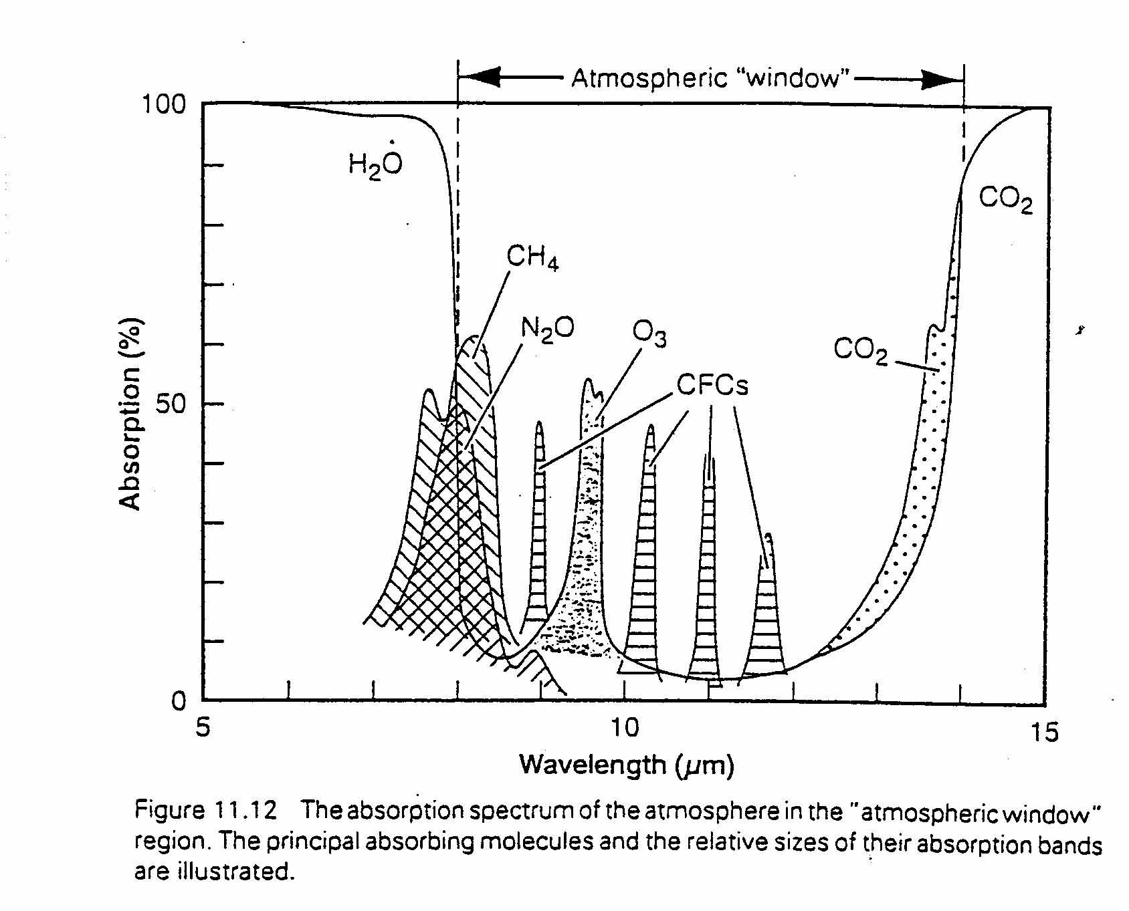
Atmospheric Window

Slide 20
Global Warming Potential
Another important term is Global Warming Potential (GWP) which takes into account both radiative forcing and atmospheric lifetime. Again the comparison is to CO₂ which is assigned a GWP of 1.0

Slide 21
Carbon Dioxide
What do we know about how CO₂ levels have changed over time?
The next slides shows the history of atmospheric CO₂ from ice core data in the Antarctic for the last 1000 years.
It appears that pre-industrial concentrations of CO₂ were fairly stable between 270 and 285 ppm. But in the last 150 years or so, the CO₂ concentration has increased by well over 100 ppm. No one disputes that this very substantial percentage increase is due to anthropogenic activities.

Slide 22
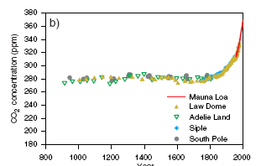

Slide 23
Mauna Loa
Since 1958, direct CO₂ measurements have been taken at the Mauna Loa observatory in Hawaii. The observatory is at 11,000 ft on a barren, volcanic mountain. It is considered an ideal place to measure ambient CO₂ levels that are not influenced by vegetation or local anthropogenic activities because it is in the middle of the Pacific Ocean.
By the time Mauna Loa measurements started in 1958, the levels had risen from 270 to 315 ppm. They have continued to rise ever since (about 50% since 1750).
CO₂ levels have increased each year since to it current value 406.53 ppm in 2017 (ftp://aftp.cmdl.noaa.gov/products/trends/co2/co2_annmean_mlo.txt).

Slide 24
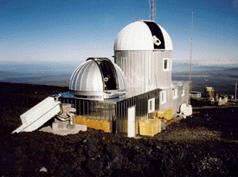

Slide 25
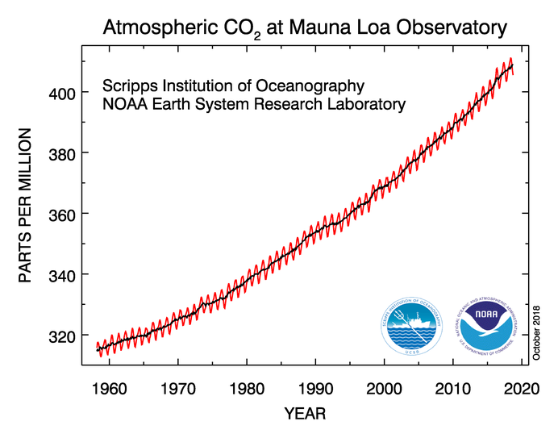
http://www.esrl.noaa.gov/gmd/ccgg/trends/full.html

Slide 26
Temperature and Ice Cores
As shown in the following slide, the temperature over the Antarctic has been 10 ºC colder and about 2 ºC warmer than the temperature in 1950 over the last 400,000 years Notice the remarkable relationship between CO₂ concentrations and temperature.
(Note: Current CO₂ levels, as well as CH₄ and N₂O, are higher than at any time in the last 800,000 yrs. You have to go back millions of years (time of dinosaurs) to find higher levels than present).

Slide 27
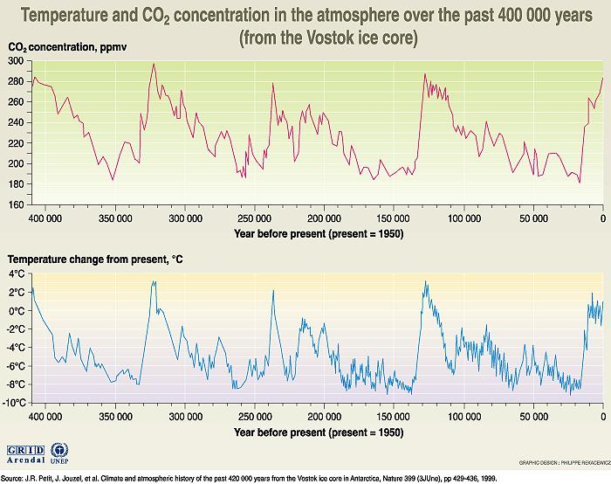

Slide 28
Global Warming
Following is from an IPCC report from October 8, 2018 on Global Warming of 1.5 ºC (http://www.ipcc.ch/report/sr15/) or from press release
  A1. Human activities are estimated to have caused approximately 1.0°C of global warming above pre-industrial levels, with a likely range of 0.8°C to 1.2°C. Global warming is likely to reach 1.5°C between 2030 and 2052.
  A1.2. Warming greater than the global annual average is being experienced in many land regions and seasons, including two to three times higher in the Arctic. Warming is generally higher over land than over the ocean.
  “The good news is that some of the kinds of actions that would be needed to limit global warming to 1.5ºC are already underway around the world, but they would need to accelerate,”
  The report finds that limiting global warming to 1.5°C would require “rapid and far-reaching” transitions in land, energy, industry, buildings, transport, and cities.
  Global net human-caused emissions of carbon dioxide (CO2) would need to fall by about 45 percent from 2010 levels by 2030, reaching ‘net zero’ around 2050.

Slide 29
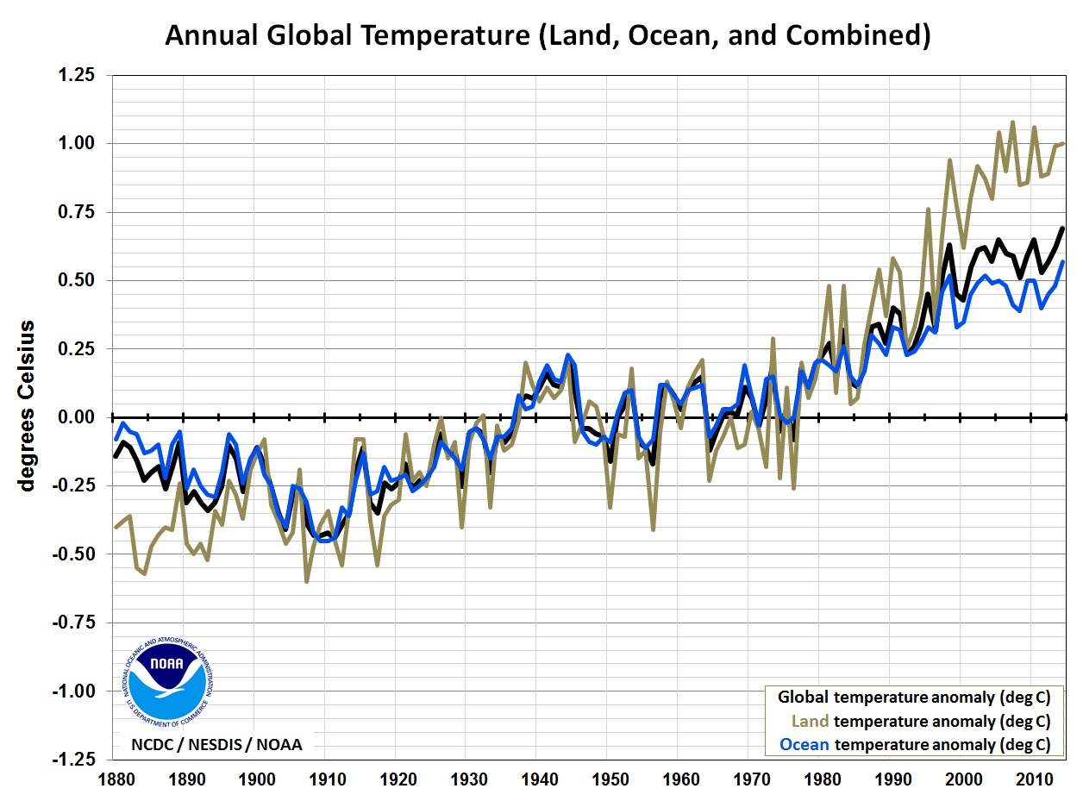
http://www.ncdc.noaa.gov/sotc/summary-info/global/2014/12

Slide 30
Fig SPM.7 a

